Slide 1
The Falls at Snohomish Cascade
Fence Research &
Advisory Presentation
September 2014

Slide 2
Agenda
The Fence’s current condition
The Falls Fence History
Research & Advisory Team Charter
Research & Advisory Process
Proposal Review (Pros and Cons)
Proposal Legal Review
Q&A

Slide 3
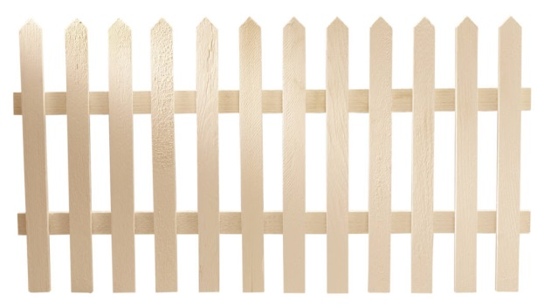
The Falls Fence History

Slide 4

The First Nineteen Years
Common Area Fence History 1990-2009
Extensive Written Record Exists Regarding Common Area Fence
Notes:
No need to speculate as to who owned or did or not do what

Slide 5
The First Nineteen Years
Common Area Fence History 1990-2009
Extensive Written Record Exists Regarding Common Area Fence History
  No need to speculate on what was done or who was responsible
Notes:
No need to speculate as to who owned or did or not do what

Slide 6
The First Nineteen Years
Common Area Fence History 1990-2009
Extensive Written Record Exists Regarding Common Area Fence History
  Written Record establishes all maintenance and repair of fences wholly planned, managed, and completed by the SCHOA Board of Directors for nineteen years

Slide 7
The First Nineteen Years
Common Area Fence History 1990-2009
Written Record establishes all responsibility for fence maintenance and repair assumed by SCHOA Board
  March 1994, Source: Invoice from Cascade Fence to SCHOA
    SCHOA paid $10,148 for repairs to over 1000 linear feet of common area fence including replacing boards and painting

Slide 8
The First Nineteen Years
Common Area Fence History 1990-2009
Written Record establishes all responsibility for fence maintenance and repair assumed by SCHOA Board
  August 1995, Source: SCHOA Board Meeting Minutes 8/30/95
    326 fence panels replaced on common area fence at cost of $1500

Slide 9
The First Nineteen Years
Common Area Fence History 1990-2009
Written Record establishes all responsibility for fence maintenance and repair assumed by SCHOA Board
  March 2000, Source: Falls Newsletter August 2000 Vol. IV No.3
    Entire fence (well over 1 mile of fencing) repainted and paid by SCHOA

Slide 10
The First Nineteen Years
Common Area Fence History 1990-2009
Written Record establishes all responsibility for fence maintenance and repair assumed by SCHOA Board
  January 2003, Source: Falls Newsletter Vol. VII No.1
    100 plus section of common area fence replaced including posts and boards

Slide 11
The First Nineteen Years
Common Area Fence History 1990-2009
Written Record establishes all responsibility for fence maintenance and repair assumed by SCHOA Board
  April 2005, Source: SCHOA Board Meeting Minutes April 12
    Sections of common area fence replaced because of storm damage

Slide 12
The First Nineteen Years
Common Area Fence History 1990-2009
Additional documents showing SCHOA assuming responsibility for all common area fence issues (this is a partial list):
  May 2004, Board Meeting Minutes May 10
  November 2004, Board Meeting Minutes Nov.9
  July 2005, Board Meeting Minutes July 12

Slide 13
A Change In Direction?
Common Area Fence History 2009-Present

Slide 14
A Change In Direction?
Common Area Fence History 2009-Present
May 2009: First indication from SCHOA Board of Directors that they might discontinue accepting sole responsibility for common area fence repair and maintenance

Slide 15
A Change In Direction?
Common Area Fence History 2009-Present
May 2009: First indication from SCHOA Board of Directors that they might discontinue accepting sole responsibility for common area fence repair and maintenance
  May 2009 Falls Board Meeting Written Agenda: “Common Area Fence, Share Cost With Adjoining Homeowner…Common Fence, Who Pays The Cost?”

Slide 16
A Change In Direction?
Common Area Fence History 2009-Present
  Board to homeowners, May 13 2009: “Problem: In the past, the Association as a whole as paid for repair of the common fence along Snohomish Cascade Drive and Puget Park Drive. Given our financial situation, should the Association require homeowners along the common fence to pay for repairs to their portion of the fence?”

Slide 17
A Change In Direction?
Common Area Fence History 2009-Present
Why the change?
    The Board clearly explained what happened, in a letter to Falls Homeowners from February, 2010

Slide 18
A Change In Direction?
Common Area Fence History 2009-Present
February 2010 Letter to Falls Homeowners from SCHOA Board of Directors
  “…Board is $30,000 in the red…
  “…essential immediate changes must to be made to our financial situation..”
  “…Failed experiment with a ‘professional’ property manager terminated…”
  “…we have no reserves to deal with common fence issues…”

Slide 19
A Change In Direction?
Common Area Fence History 2009-Present
In September, 2010, the written record indicates that the Board found, implemented, and reported to homeowners their solution to the fence problem that they identified in 2009

Slide 20
A Change In Direction?
Common Area Fence History 2009-Present
Solution
    September 12, 2010 letter from SCHOA Board of Directors to homeowners: “The fences will be replaced with a new, attractive, and stronger design. As a result of raising the annual maintenance assessment (homeowners dues) earlier this year in anticipation of this project, we have collected half the money required to do so and expect the monies received from 2011 homeowners dues to satisfy any remaining requirements…

Slide 21
A Change In Direction?
Common Area Fence History 2009-Present
In a letter to homeowners from August of 2011, the Board refers to a poll of homeowners undertaken by the Board in 2010

Slide 22
A Change In Direction?
Common Area Fence History 2009-Present
“In 2010 owners were asked to vote on whether the Association should undertake and pay for repairs to the fencing bordering the common areas. The consensus of the owners was that because the fencing benefits both the Association and the owners of the adjacent lots, the Association should cover half the cost, and the rest of the cost would be shared by lot owners bordering the fence. This idea and the process adopted by the previous board works well as long as each owner pays their 50% share. The problem we face is if any owner fails to pay…”(Emphasis added)

Slide 23
Current Situation
Common Area Fence History 2009-Present
The Current Board has created a Fence Research and Advisory Committee charged with several tasks

Slide 24
Research & Advisory Team Charter
Gather accurate facts regarding fence location
Compile accurate history of fence maintenance and repair
Review legal advice given in the past regarding maintenance and repair of fences and whether HOA funds may be legally used for such purposes
Evaluate the law and the HOA’s governing documents in considering options regarding the fences
Consider all options regarding fence replacement
Identify several options which the Team believes are both legal and viable
Obtain the concurrence of independent legal counsel as to the legality of such options
Recommend several fence options to the board which are both legal and viable
Educate the members of the association as to the Team’s recommendations

Slide 25
Fence Research & Advisory Process
Process for determining the proposals
Step 1: Establish Committee ground rules for interaction and aligning with the charge
Step 2: Review Fence history documentation (newsletters, meeting minutes, legal docs, etc.)
Step 3: Review of Fence Survey results to determine any intent regarding fence lines
Step 4: Brainstorming of ideas that were viable, legal and financially possible
Notes:
Finding an option that would meet everyone's needs may not be possible.
No single document could be used to 100% prove a particular position.
Solving the issue one way now does not mean that is how it has to be done in the future (may require CCR changes to resolve future issue)

Slide 26
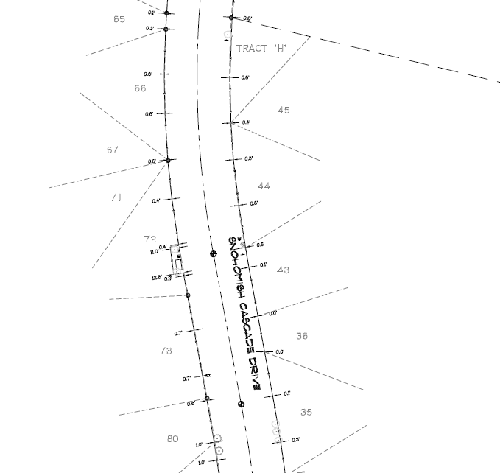
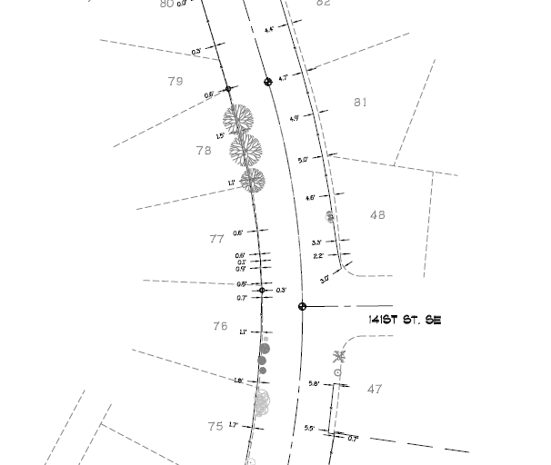
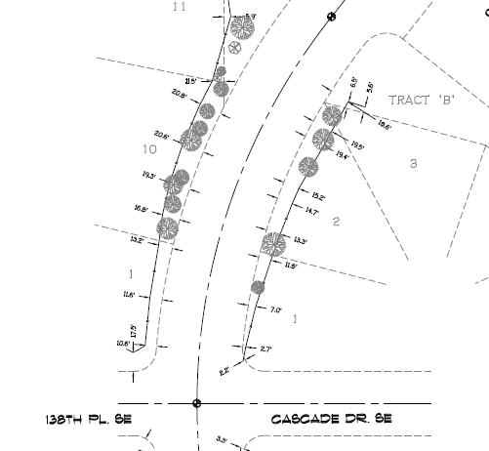
Fence Land Survey (Overview)
Figure 1
Figure 2
Figure 3
Avg. of 4.6’
Avg. of < 1’
Avg. of 0.9’
Avg. of 16’
Notes:
In most cases the fence appears to follow property lines where grade/landscape allowed (see figure 1)
No consistent placement found to be on or off home owner or HOA property (varies through out survey)
There are several sections where landscape or grade seems to dictate fence placement (see figures 2 & 3)

Slide 27
Proposal Overview
Committee discussed/researched various options (HOA Loan, Hedges, CCR changes, etc.)
Many of the discussed options had too many risks, unknowns, legal issues and/or CCR changes involved.
Taking everything into consideration narrowing down the following three choices made the most sense and covered a majority of the different perspectives involved.
  HOA pay for 100% of fence
  Cost sharing with Home Owners (50/50 split)
  Change CCRs to require homeowners to replace fence
Notes:
All options will require HOA funds, have an impact on homeowners and our overall community (property values, appearance, etc.)
They require the community to work together through budgeting, HOA support or CCR changes

Slide 28
Proposal Review (Pro and Cons)
Option #1: HOA Pays 100% for Fence
Pros | Cons
◦ Uniform design and concurrent maintenance | ◦ Initial Expense/Becomes HOA budget item
◦ Fundable without Special Assessment | ◦ Some neighbors unhappy with choice
◦ No increase in dues
◦ Improves Property Values
◦ Timelier action for repairs/replacement
◦ No CC&R amendments required

Slide 29
Proposal Review (Pro and Cons) Cont.
Option #2: Cost Sharing: 50/50 Split with HOA & Homeowners on Fence line
Pros | Cons
◦ Lower cost to HOA | ◦ CC&R amendments required
◦ May be acceptable to homeowners | ◦ Requires 240 homeowners to approve (75% yes vote)
◦ No special assessment required | ◦ Legal issues over who is responsible for repairs
◦ No increase in dues | ◦ Non payments from homeowners—what to do--liens
◦ Improves Property Values | ◦ Uniformity issues: style and color
 | ◦ Timelines: will take more time to address fence issue
 | ◦ Requires more money to draft new CC&R’s

Slide 30
Proposal Review (Pro and Cons) Cont.
Option #3: Change CC&R’s to require homeowners to replace fence
Pros | Cons
◦ No funding required from HOA | ◦ CC&R amendments required
 | ◦ Requires 240 homeowners to approve (75% yes vote)
 | ◦ More legal issues
 | ◦ Non payments from homeowners—what to do--liens
 | ◦ Uniformity issues: style and color
 | ◦ Timelines: will take more time to address fence issue
 | ◦ Requires more money to draft new CC&R’s

Slide 31
Questions?
Please Note:
All Fence Research & Advisory Team reference materials (newsletters, meeting minutes, legal documents, surveys, etc.) will be available on the community website beginning 9/19/2014
http://www.thefalls-schoa.com/

Slide 32
Fence Research and Advisory Team Members
Phil Bastian
Jacob Britt
Kelly Daylong
Colleen Ferrari
John Logan
Susan Ridley

